Slide 1

Employee Promotion Prediction using Machine Learning
ML Hackathon Analytics Vidhya
Sathyan Asokan Geethpriya
1/4/2026

Slide 2

Problem Statement
Business Problem
Employee promotions are often subjective and inconsistent
Manual evaluation is time-consuming and biased
HR teams need data-driven promotion decisions
Goal
Predict whether an employee is eligible for promotion
Improve fairness, accuracy, and efficiency

Slide 3
Dataset overview
Employee demographic and performance data
Features include:
Age
Education
Department
Previous ratings
Years of service
Training scores

Slide 4
Data Preprocessing
Steps Performed
Missing value handling
Categorical encoding (One-Hot Encoding)
Feature scaling (where applicable)
Train / validation split
Why This Matters
Clean data improves model accuracy
Ensures consistent inference during deployment

Slide 5

Model Development
Model Used
Machine Learning classifier (e.g., Random Forest / Logistic Regression / XGBoost)
Why This Model
Handles structured tabular data well
Interpretable results
Strong baseline performance
Model Persistence
Trained model saved as .pkl file

Slide 6

Model Performance
Evaluation Metrics
Accuracy
Precision
Recall
F1-Score
The results? Model achieved strong predictive performance

Slide 7

The Application Architecture
System Components
Streamlit UI (Frontend)
Scikit-learn ML Model
Docker Container
Google Cloud Run (Serverless)
Flow
User inputs employee data
Model predicts promotion eligibility
Result displayed instantly

Slide 8
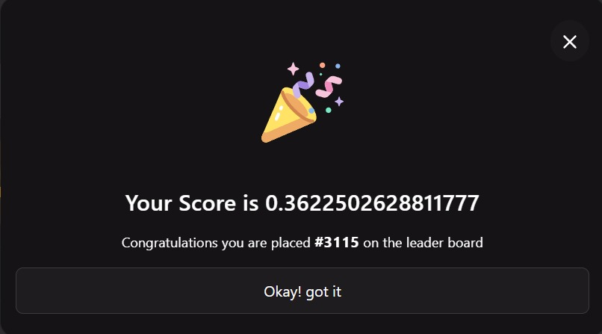
API score

Slide 9
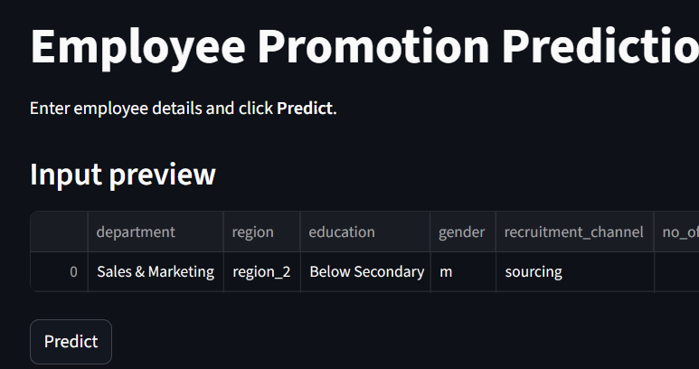

Slide 10
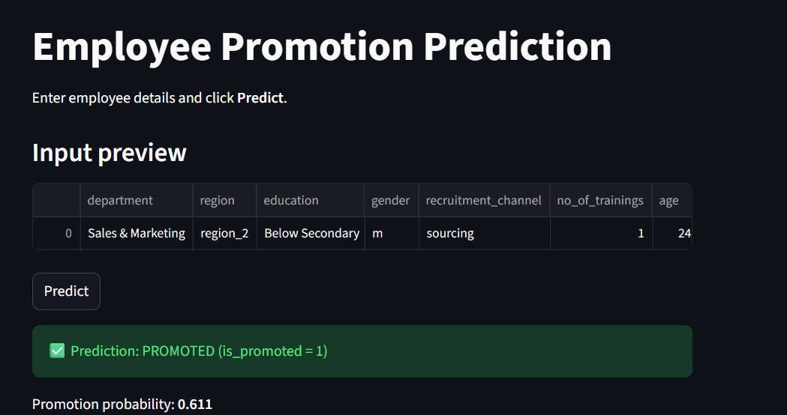

Slide 11
Links:
https://employee-promotion-app-lswmhc3zmvtbb3kpjvpvup.streamlit.app/
https://github.com/Sathyan26/employee-promotion-streamlit

